Slide 1
Chongqing University of Technology
ATAI
Advanced Technique of Artificial Intelligence
Chongqing University of Technology
Weakly-Supervised Aspect-Based Sentiment Analysis via Joint
Aspect-Sentiment Topic Embedding(EMNLP 2020)
Jiaxin Huang, Yu Meng, Fang Guo, Heng Ji, Jiawei HanUniversity of Illinois at Urbana-Champaign, IL, USA
Reported by jia wang

Slide 2
Chongqing University of Technology
ATAI
Advanced Technique of Artificial Intelligence
Chongqing University of Technology
1. Introduction
2. Related Work
3. Problem Definition
4. Model
5. Evaluation
6. Conclusion

Slide 3
Introduction
Aspect-based sentiment analysis contains two sub-tasks:
Aspect extraction and sentiment polarity classification.
The former identifies the aspect covered in the review, whereas the latter decides its sentiment polarity.

Slide 4
Introduction
Our contributions can be summarized as follows:
(1) We propose a weakly-supervised method JASen to enhance two sub-tasks of aspect-based sentiment analysis. Our method does not need any annotated data but only a few keywords for each aspect/sentiment.
(2) We introduce an embedding learning objective that is able to capture the semantics of fine-grained joint topics of <sentiment, aspect> in the word embedding space.
(3) We demonstrate that JASen generates high-quality joint topics and outperforms baselines significantly on two benchmark datasets.

Slide 5
Introduction
Figure 1: Two sample restaurant reviews. Pure aspect words are in red and wavy-underlined, and generalopinion words are in blue and framed in boxes. Wordsimplying both aspects and opinions (which we defineas joint topics) are underlined and in purple.

Slide 6
Related Work
●Aspect Extraction
•Early studies towards aspect extraction are mainly based on manually defined rules.
•Various unsupervised approaches are proposed to model different aspects automatically.(LDA- based methods)

Slide 7
Related Work
●Joint Extraction of Aspect and Sentiment
•Most previous studies that jointly perform aspect and sentiment extraction are LDA-based methods.
•they suffer from the drawback of not imposing discriminative constraints among topic-word distribution can largely overlap among different topics, allowing redundant topics to appear and making it hard to classify them.

Slide 8
Problem Definition
Our weakly-supervised aspect-based sentiment analysis task is defined as follows. The input is a training corpus D = {d1, d2, . . . , d|D|} of text reviews from a certain domain (e.g., restaurant or laptop) without any label for aspects or sentiment.
A list of keywords la for each aspect topic (denoted as a ∈ A) and ls for each sentiment polarity (denoted as s ∈ S) are provided by users as guidance.
For each unseen review in the same domain, our model outputs a set of <s, a> labels.

Slide 9
Model

Slide 10
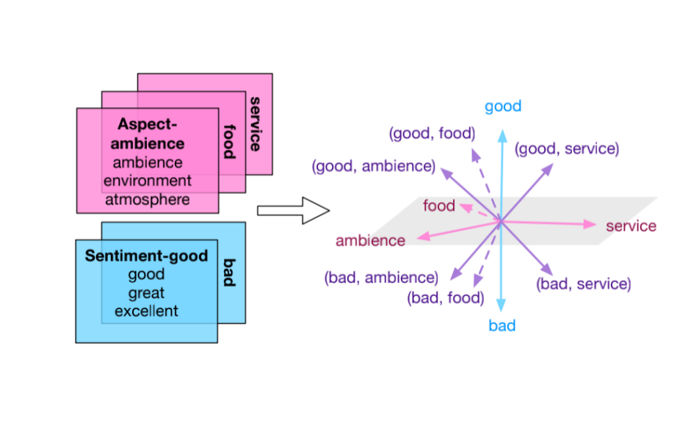
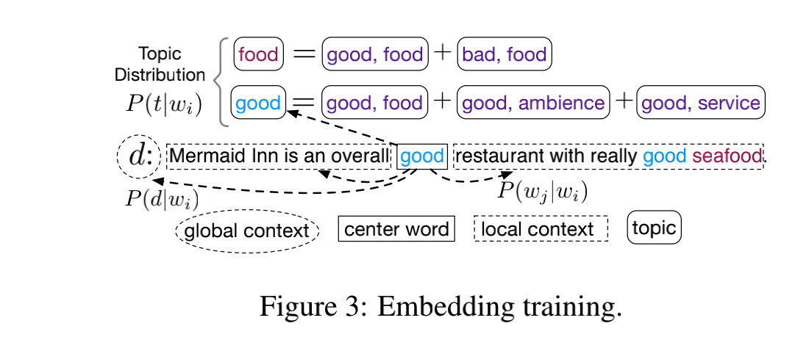
Model
Modeling Local and Global Contexts.
where P(wj |wi) ∝ exp(v>j ui), and ui, vj are the
center and context word embeddings.
where P(d|wi) ∝ exp(d>ui).
Regularizing Pure Aspect/Sentiment Topics.

Slide 11
Model
Regularizing Joint <Sentiment, Aspect> Topics.
where Lreg = LAreg +LSreg, and the same for Ljoint and Lcross.

Slide 12
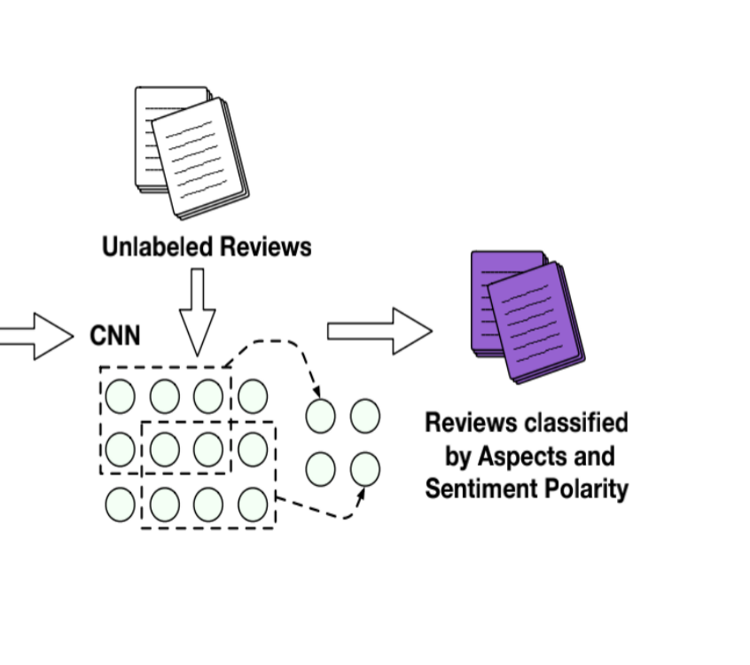
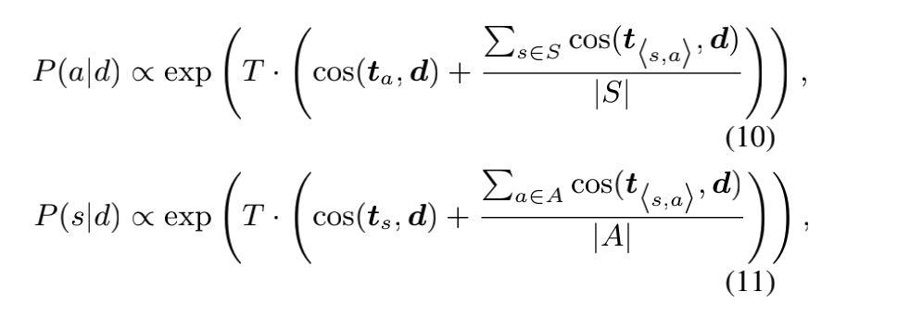
Model
Training CNNs for Classification
Neural Model Pre-training.
We leverage the knowledge distillation objective to minimize the cross entropy between the embedding-based prediction pd and the output prediction qd of the CNNs:
Example:
•“Any movie is better than this one”
VS
•“This one is better than any movie”

Slide 13
Model
Neural Model Refinement.

Slide 14
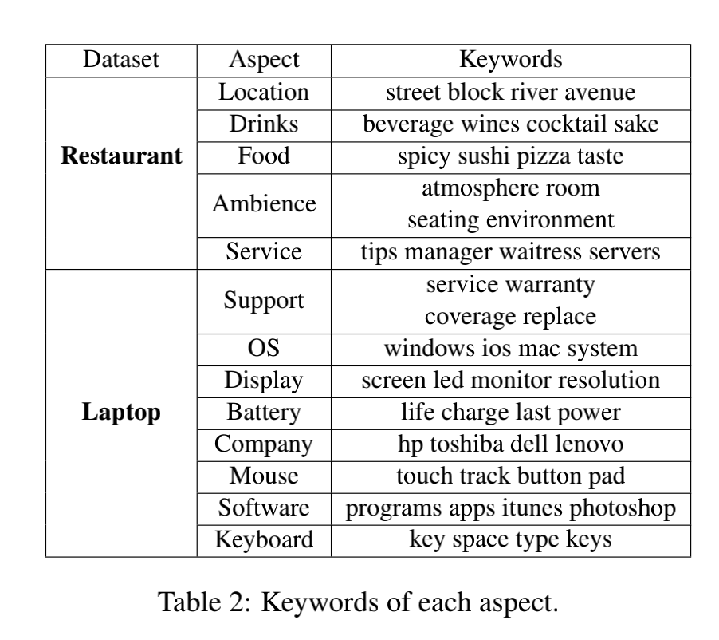
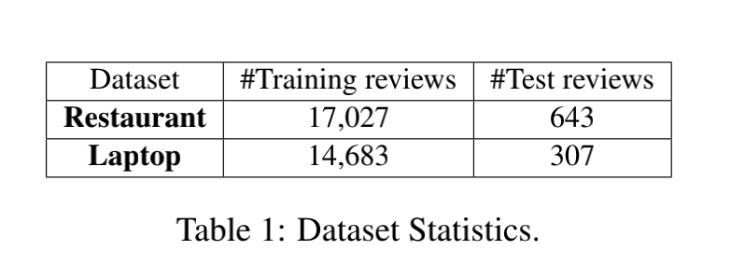
Evaluation

Slide 15
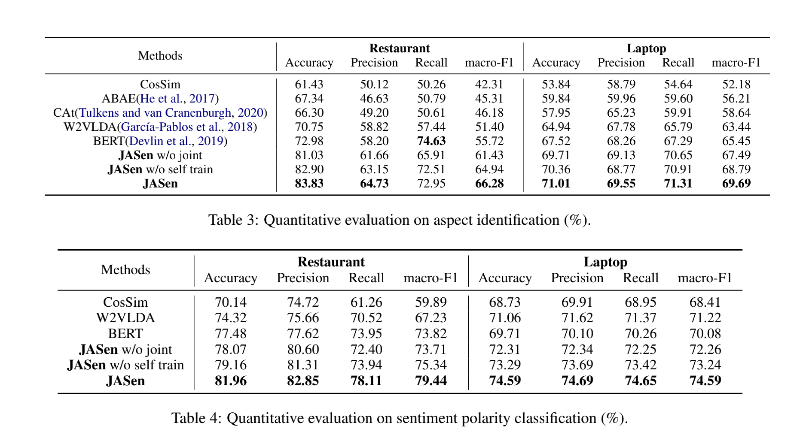
Evaluation

Slide 16
Evaluation

Slide 17
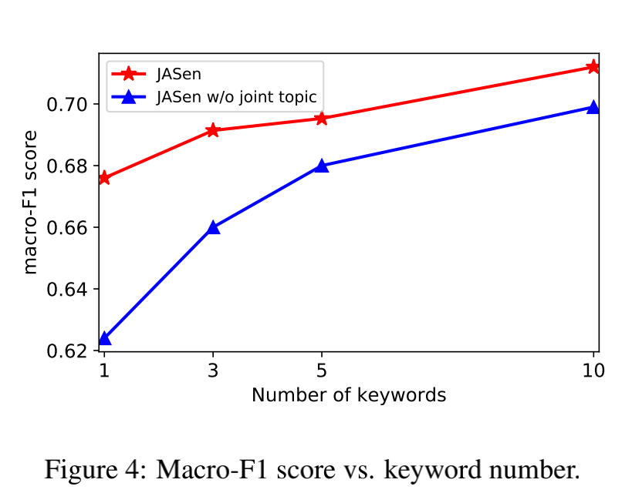
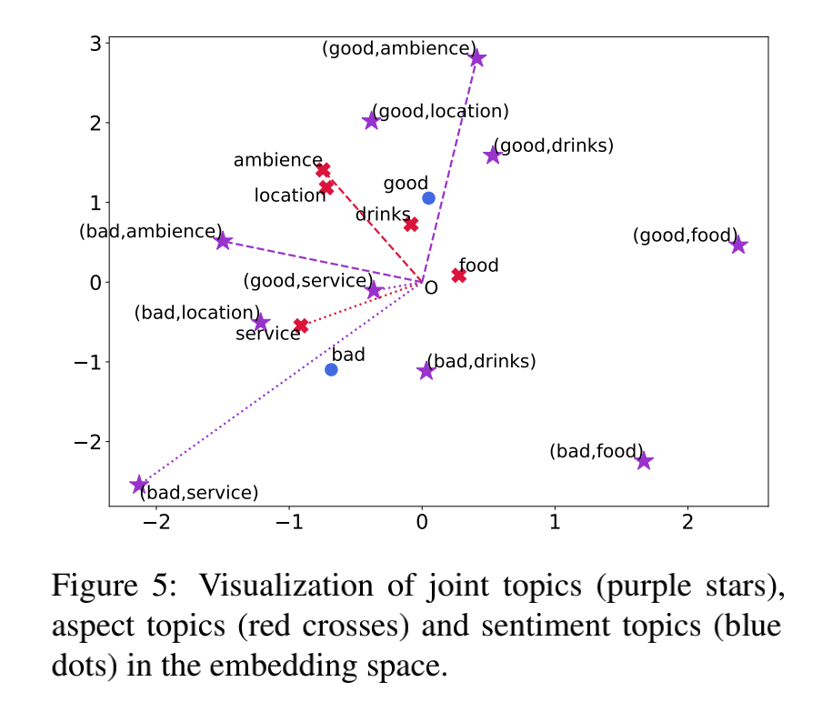
Evaluation

Slide 18
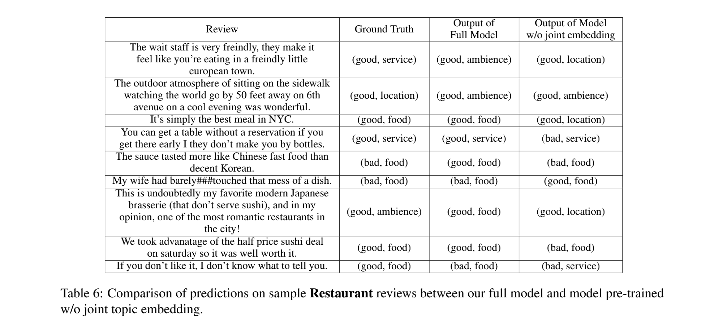
Evaluation

Slide 19
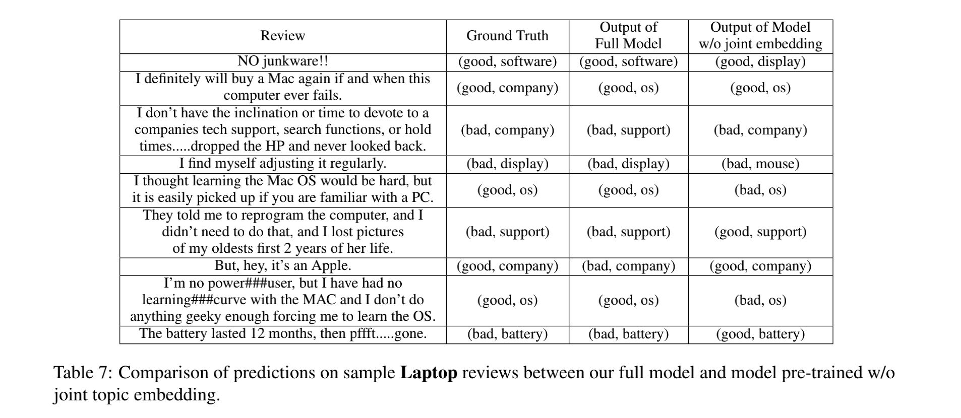
Evaluation

Slide 20
Conclusion
In this paper we propose to enhance weakly supervised aspect-based sentiment analysis by learning the representation of <sentiment, aspect> joint topic in the embedding space to capture more fine-grained information. We introduce an embedding learning objective that leverages user given keywords for each aspect/sentiment and models their distribution over the joint topics. The embedding-based predictions are then used for pretraining neural models, which are further refined via self-training on unlabeled corpus. Experiments show that our method learns high-quality joint topics and outperforms previous studies substantially.

Slide 21
Thanks

